Slide 1
This is CS50

Slide 2
input →
→ output

Slide 3
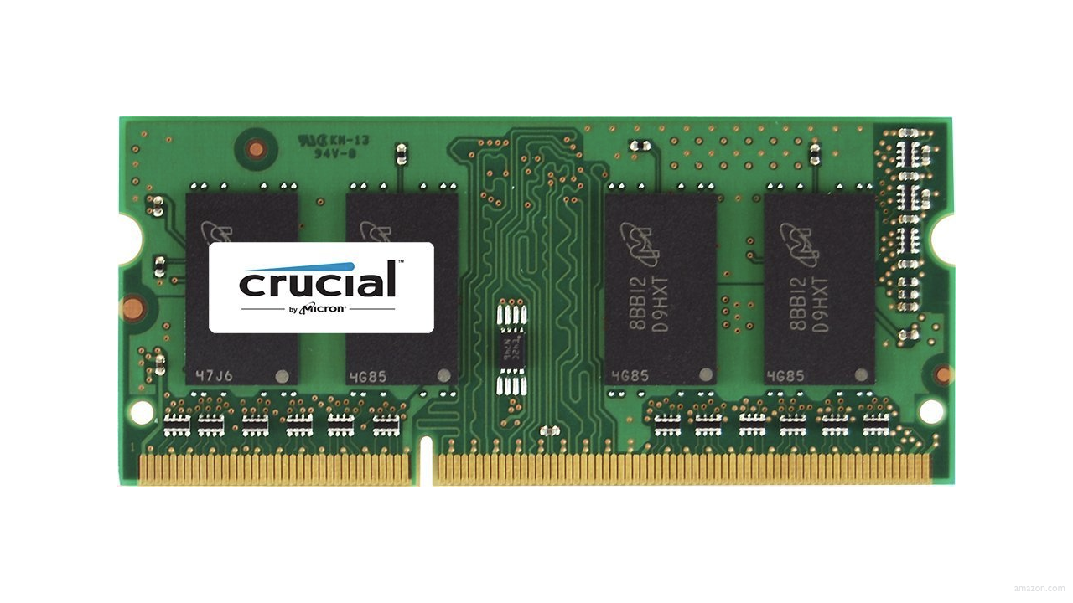

Slide 7
 | 4 | 6 | 8 | 2 | 7 | 5 | 0

Slide 9
 | [0] | [1] | [2] | [3] | [4] | [5] | [6]

Slide 10
searching

Slide 11
input →
→ output

Slide 12

→
→ output

Slide 13
→
→ bool

Slide 14
algorithms

Slide 15
running times

Slide 16
O

Slide 17
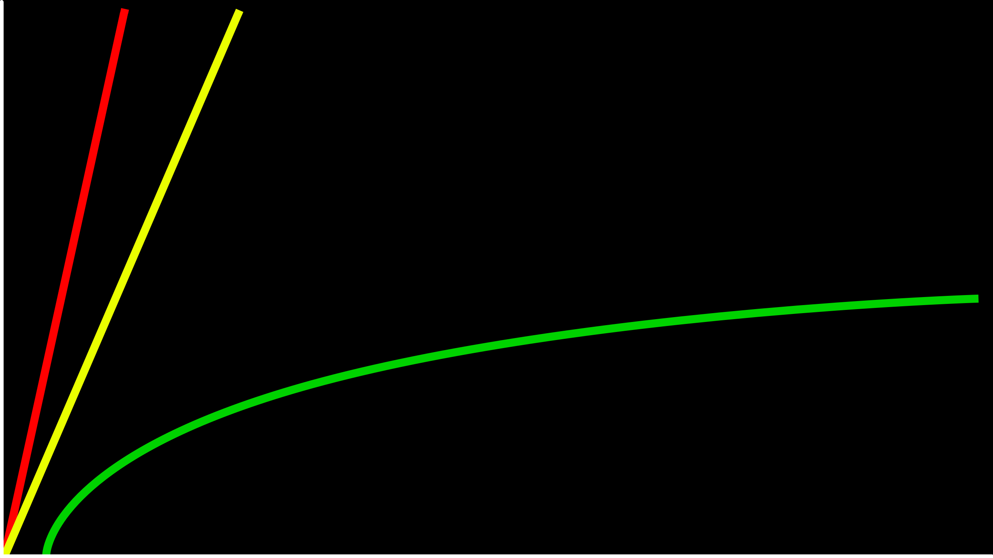
time to solve
size of problem

Slide 18
O(n)
O(n/2)
time to solve
O(log₂n)
size of problem

Slide 19
O(n)
O(n/2)
time to solve
O(log₂n)
size of problem

Slide 20
O(n)
O(n)
time to solve
O(log₂n)
size of problem

Slide 21
O(n)
O(n)
time to solve
O(log n)
size of problem

Slide 22
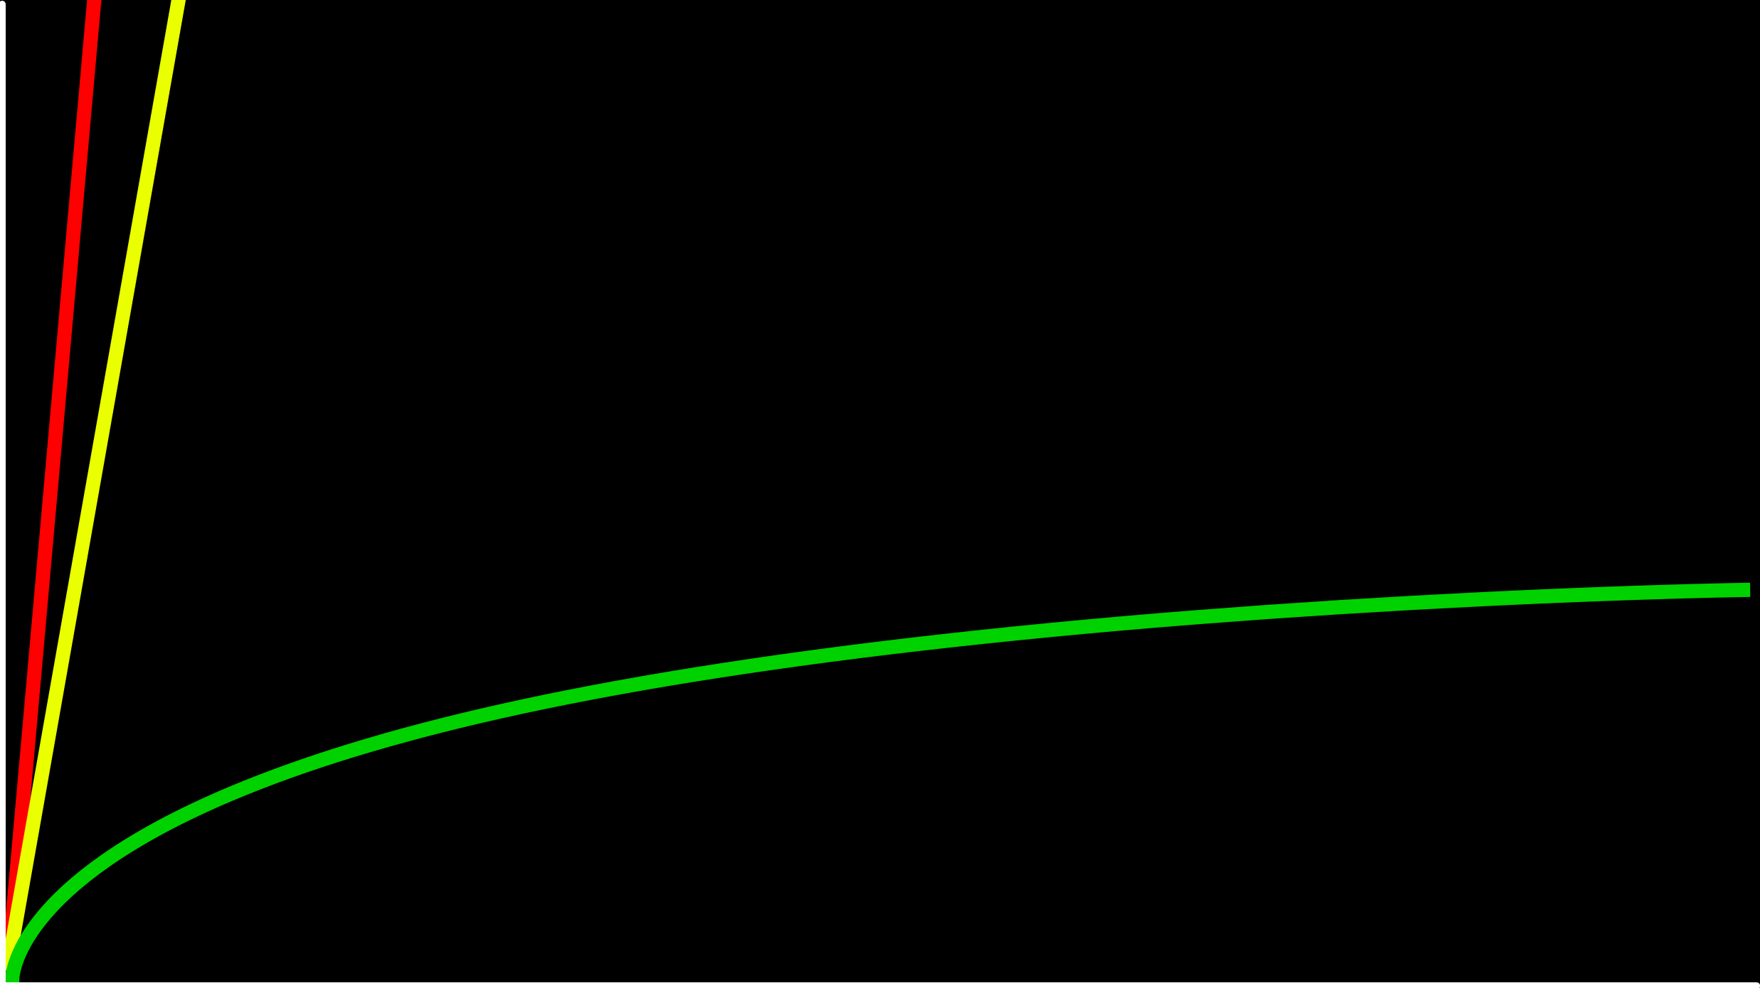
O(n)
time to solve
O(log n)
size of problem

Slide 23
O(n²)
O(n log n)
O(n)
O(log n)
O(1)

Slide 24
Ω

Slide 25
Ω(n²)
Ω(n log n)
Ω(n)
Ω(log n)
Ω(1)

Slide 26
Θ

Slide 27
Θ(n²)
Θ(n log n)
Θ(n)
Θ(log n)
Θ(1)

Slide 28
linear search
Notes:
4 6 8 2 7 5 0

Slide 29
For each door from left to right
If number is behind door
Return true
Return false

Slide 30
For i from 0 to n-1
If number behind doors[i]
Return true
Return false

Slide 31
O(n²)
O(n log n)
O(n)
O(log n)
O(1)

Slide 32
O(n²)
O(n log n)
O(n) linear search
O(log n)
O(1)

Slide 33
Ω(n²)
Ω(n log n)
Ω(n)
Ω(log n)
Ω(1)

Slide 34
Ω(n²)
Ω(n log n)
Ω(n)
Ω(log n)
Ω(1) linear search

Slide 35
binary search
Notes:
0 2 4 5 6 7 8

Slide 36
If number behind middle door
Return true
Else if number < middle door
Search left half
Else if number > middle door
Search right half

Slide 37
If no doors
If number behind middle door
Return true
Else if number < middle door
Search left half
Else if number > middle door
Search right half

Slide 38
If no doors
Return false
If number behind middle door
Return true
Else if number < middle door
Search left half
Else if number > middle door
Search right half

Slide 39
If no doors
Return false
If number behind doors[middle]
Return true
Else if number < doors[middle]
Search doors[0] through doors[middle - 1]
Else if number > doors[middle]
Search doors[middle + 1] through doors[n - 1]

Slide 40
O(n²)
O(n log n)
O(n)
O(log n)
O(1)

Slide 41
O(n²)
O(n log n)
O(n)
O(log n) binary search
O(1)

Slide 42
Ω(n²)
Ω(n log n)
Ω(n)
Ω(log n)
Ω(1)

Slide 43
Ω(n²)
Ω(n log n)
Ω(n)
Ω(log n)
Ω(1) binary search

Slide 44
int numbers[]
Notes:
numbers.c

Slide 45
string names[]
Notes:
names.c

Slide 46
string names[]
string numbers[]
Notes:
phonebook0.c

Slide 47
data structures

Slide 48
person people[]

Slide 49
string name;
string number;

Slide 50
typedef struct
{
string name;
string number;
}
person;
Notes:
phonebook1.c
we'll see a way to save phonebook eventually

Slide 51
sorting

Slide 52
input →
→ output

Slide 53
unsorted →
→ output

Slide 54
unsorted →
→ sorted

Slide 55
→
→ sorted
6 3 8 5 2 7 4 1

Slide 56
→
→
6 3 8 5 2 7 4 1
1 2 3 4 5 6 7 8

Slide 57
selection sort

Slide 58
5 2 7 4 1 6 3 0

Slide 59
For i from 0 to n-1
Find smallest number between numbers[i] and numbers[n-1]
Swap smallest number with numbers[i]
Notes:
https://www.cs.usfca.edu/~galles/visualization/ComparisonSort.html

Slide 60
 | [0] | [1] | [2] | ... | [n-3] | [n-2] | [n-1]

Slide 62
n

Slide 63
n + (n – 1)

Slide 64
n + (n – 1) + (n – 2)

Slide 65
n + (n – 1) + (n – 2) + ... + 1

Slide 66
n + (n – 1) + (n – 2) + ... + 1
n(n + 1)/2

Slide 67
n + (n – 1) + (n – 2) + ... + 1
n(n + 1)/2
(n² + n)/2

Slide 68
n + (n – 1) + (n – 2) + ... + 1
n(n + 1)/2
(n² + n)/2
n²/2 + n/2

Slide 69
n + (n – 1) + (n – 2) + ... + 1
n(n + 1)/2
(n² + n)/2
n²/2 + n/2
O(n²)

Slide 70
O(n²)
O(n log n)
O(n)
O(log n)
O(1)

Slide 71
O(n²) selection sort
O(n log n)
O(n)
O(log n)
O(1)

Slide 72
For i from 0 to n-1
Find smallest number between numbers[i] and numbers[n-1]
Swap smallest number with numbers[i]

Slide 73
Ω(n²)
Ω(n log n)
Ω(n)
Ω(log n)
Ω(1)

Slide 74
Ω(n²) selection sort
Ω(n log n)
Ω(n)
Ω(log n)
Ω(1)

Slide 75
Θ(n²)
Θ(n log n)
Θ(n)
Θ(log n)
Θ(1)

Slide 76
Θ(n²) selection sort
Θ(n log n)
Θ(n)
Θ(log n)
Θ(1)

Slide 77
bubble sort
Notes:
6 3 8 5 2 7 4 1

Slide 78
5 2 7 4 1 6 3 0

Slide 79
Repeat n-1 times
For i from 0 to n-2
If numbers[i] and numbers[i+1] out of order
Swap them
Notes:
https://www.cs.usfca.edu/~galles/visualization/ComparisonSort.html

Slide 80
 | [0] | [1] | [2] | ... | [n-3] | [n-2] | [n-1]

Slide 82
(n – 1) × (n – 1)

Slide 83
(n – 1) × (n – 1)
n² – 1n – 1n + 1

Slide 84
(n – 1) × (n – 1)
n² – 1n – 1n + 1
n² – 2n + 1

Slide 85
(n – 1) × (n – 1)
n² – 1n – 1n + 1
n² – 2n + 1
O(n²)

Slide 86
O(n²)
O(n log n)
O(n)
O(log n)
O(1)

Slide 87
O(n²) bubble sort
O(n log n)
O(n)
O(log n)
O(1)

Slide 88
Repeat n-1 times
For i from 0 to n-2
If numbers[i] and numbers[i+1] out of order
Swap them
If no swaps
Quit

Slide 89
Ω(n²)
Ω(n log n)
Ω(n)
Ω(log n)
Ω(1)

Slide 90
Ω(n²)
Ω(n log n)
Ω(n) bubble sort
Ω(log n)
Ω(1)

Slide 91
recursion

Slide 92
If no doors
Return false
If number behind middle door
Return true
Else if number < middle door
Search left half
Else if number > middle door
Search right half

Slide 93
If no doors
Return false
If number behind middle door
Return true
Else if number < middle door
Search left half
Else if number > middle door
Search right half

Slide 94
1 Pick up phone book
2 Open to middle of phone book
3 Look at page
4 If person is on page
5 Call person
6 Else if person is earlier in book
7 Open to middle of left half of book
8 Go back to line 3
9 Else if person is later in book
10 Open to middle of right half of book
11 Go back to line 3
12 Else
13 Quit

Slide 95
1 Pick up phone book
2 Open to middle of phone book
3 Look at page
4 If person is on page
5 Call person
6 Else if person is earlier in book
7 Open to middle of left half of book
8 Go back to line 3
9 Else if person is later in book
10 Open to middle of right half of book
11 Go back to line 3
12 Else
13 Quit

Slide 96
1 Pick up phone book
2 Open to middle of phone book
3 Look at page
4 If person is on page
5 Call person
6 Else if person is earlier in book
7 Open to middle of left half of book
8 Go back to line 3
9 Else if person is later in book
10 Open to middle of right half of book
11 Go back to line 3
12 Else
13 Quit

Slide 97
1 Pick up phone book
2 Open to middle of phone book
3 Look at page
4 If person is on page
5 Call person
6 Else if person is earlier in book
7 Search left half of book
8
9 Else if person is later in book
10 Search right half of book
11
12 Else
13 Quit

Slide 98
1 Pick up phone book
2 Open to middle of phone book
3 Look at page
4 If person is on page
5 Call person
6 Else if person is earlier in book
7 Search left half of book
8 Else if person is later in book
9 Search right half of book
10 Else
11 Quit

Slide 99

Notes:
http://ian-albert.com/games/super_mario_bros_maps/

Slide 100

Notes:
iteration.c

Slide 101


Slide 102


Slide 103


Slide 104

Notes:
recursion.c

Slide 105
merge sort

Slide 106
Sort left half of numbers
Sort right half of numbers
Merge sorted halves

Slide 107
If only one number
Quit
Else
Sort left half of numbers
Sort right half of numbers
Merge sorted halves

Slide 108
If only one number
Quit
Else
Sort left half of numbers
Sort right half of numbers
Merge sorted halves

Slide 109
2 4 5 7 0 1 3 6

Slide 110
If only one number
Quit
Else
Sort left half of numbers
Sort right half of numbers
Merge sorted halves
Notes:
https://www.cs.usfca.edu/~galles/visualization/ComparisonSort.html

Slide 111
5 2 7 4 1 6 3 0

Slide 112
O(n²)
O(n log n)
O(n)
O(log n)
O(1)

Slide 113
O(n²)
O(n log n) merge sort
O(n)
O(log n)
O(1)

Slide 114
Ω(n²)
Ω(n log n)
Ω(n)
Ω(log n)
Ω(1)

Slide 115
Ω(n²)
Ω(n log n) merge sort
Ω(n)
Ω(log n)
Ω(1)

Slide 116
Θ(n²)
Θ(n log n)
Θ(n)
Θ(log n)
Θ(1)

Slide 117
Θ(n²)
Θ(n log n) merge sort
Θ(n)
Θ(log n)
Θ(1)

Slide 118
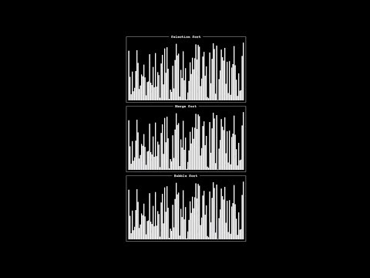
Notes:
https://www.youtube.com/watch?v=ZZuD6iUe3Pc

Slide 119
This is CS50

